Slide 1
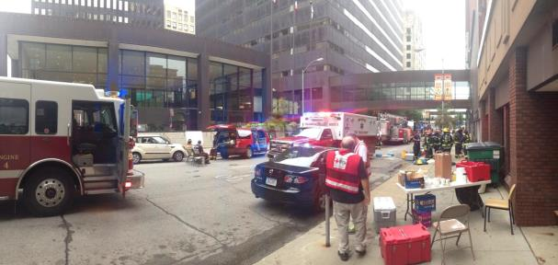
Image Quality from surveillance footage
Margaret Pinson, NTIA/ITS

Slide 2
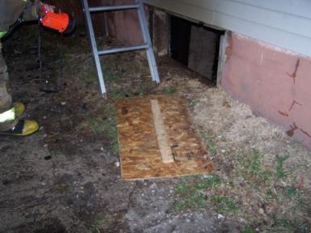
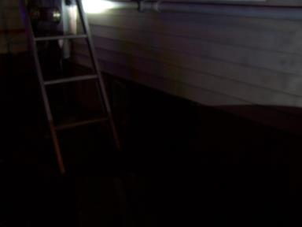
Evidence
Valuable
Useless
All photos were provided by first responders.
These actual photos show recent cases

Slide 3
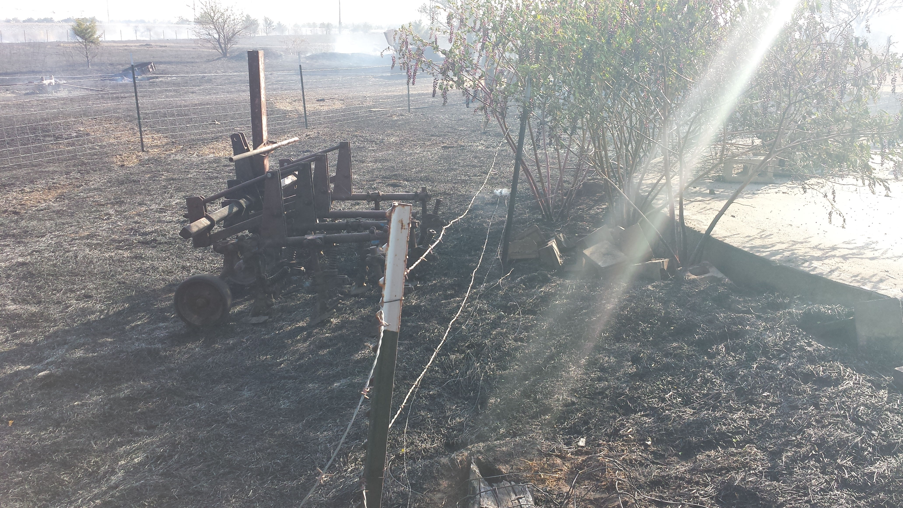
How do we avoid …

Slide 4
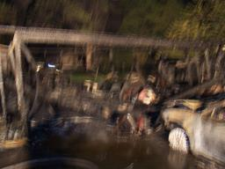
How do we avoid …

Slide 5
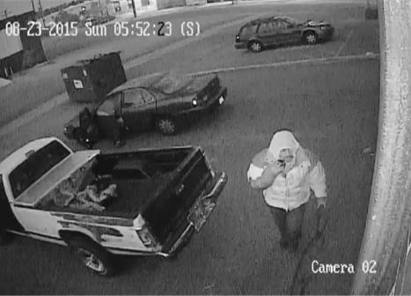
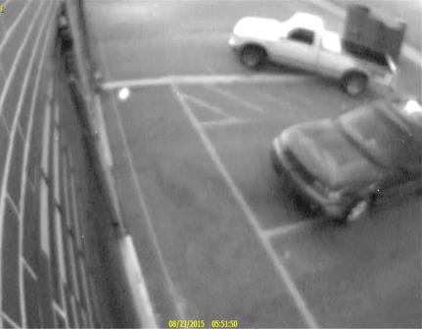
Surveillance systems
Valuable
Useless

Slide 6
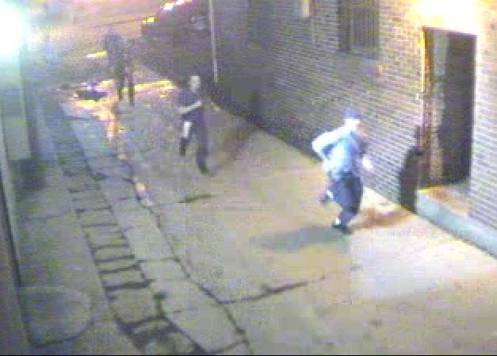
How do we avoid …

Slide 7
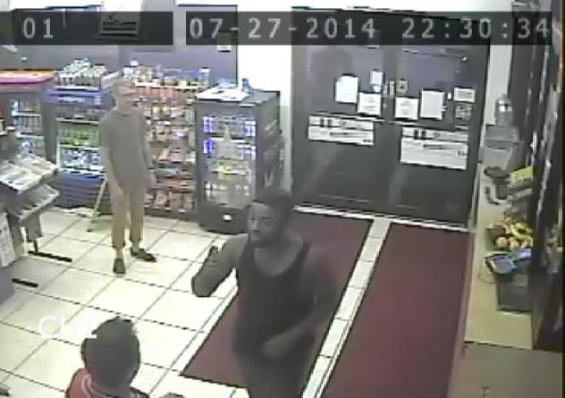
How do we avoid …

Slide 8
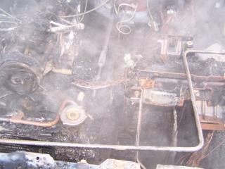
Mike Hartman Assistant Chief and Fire Marshal Muscatine, Iowa
Takes picture in field
Struggle with quality 75% of time
Low light & bad weather
Reshoot
Miss problems
Impact
Evidentiary needs not met
Must retain all images regardless
Time sink

Slide 9
Michael Bush Denver Police Crime Lab Forensic Imaging and Video Analysis
Photo from surveillance video
Monitor quality ≠ photo quality
Export frame
Face disappears
Struggle with quality 60% of time
Need identifying marks

Slide 10
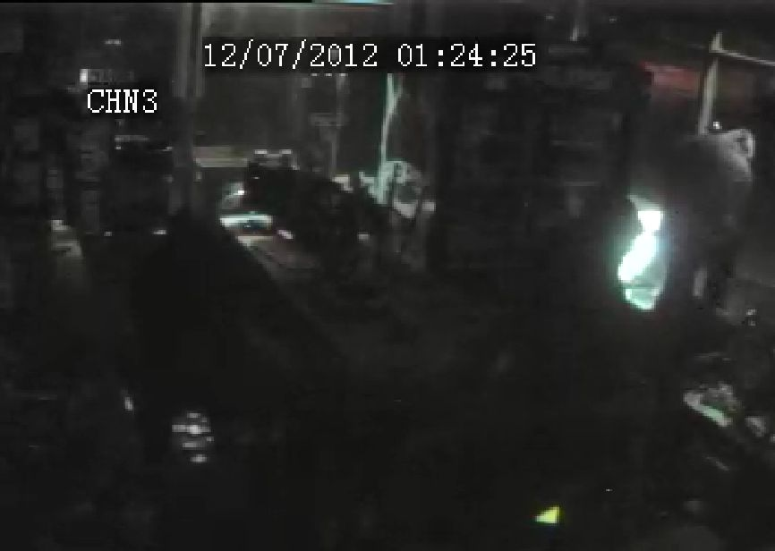
Proposal to Extend VIME
Photos from surveillance video
QCIF to 2 MP
New impairments
Fish eye lens
Video compression artifacts
Video to photo
Recompression from export
QoE issues

